Slide 1

Final Presentation
Aayush Garg
Eva Tan
Max Chua
Wu Di Yuan Yu Xuan

Slide 2




1. Schedule
2. Metrics
3. Subversion Log
4. Others
SCOPE:

Slide 3
Actual Vs Planned
10-Sep
13-Sep
27-Sep
12-Oct
Iteration 1
Iteration 2
Iteration 3
Iteration 1
Iteration 2
Iteration 3
10-Sep
13-Sep
28-Sep
17-Oct
Planned
Actual
Notes:
Planned vs Actual

Slide 4
Actual Vs Planned
18-Oct
25-Oct
26-Oct
31-Oct
1-Nov
9-Oct
11-Oct
16-Oct
Iteration 4
Iteration 5
Iteration 6
Iteration 7
Iteration 4
Iteration 5
Iteration 6
Iteration 7
18-Oct
25-Oct
26-Oct
31-Oct
1-Nov
9-Oct
11-Oct
16-Oct
Planned
Actual
Notes:
Planned vs Actual

Slide 5
Functionalities Update
No dropping/addition of functionalities
Framework: Model View Controller(MVC)
External Libraries:
GSON
IS203-JWT
JSON-SMART
NIMBUS-JOSE-JWT
MYSQL-Connector
Commons-FileUpload
Commons-IO
OpenCSV
Notes:
Planned vs Actual

Slide 6

Coding Tasks Breakdown
Functionalities | Aayush | Eva | Max | Wu Di | Yu Xuan
Bootstrap
Admin Update
Login/Logout
Basic Location Report
Heatmap
Automatic Group Detection
Group Aware Location Report
Web Service UI + JSON(-Group JSON)
Notes:
Planned vs Actual

Slide 7
Coding Tasks Breakdown
Tasks | Aayush | Eva | Max | Wu Di | Yu Xuan
Improve UI from UAT
Modify bootstrap
Implement changes from Heuristic
Group JSON
Generate javadocs (AGD, bootstrap, admin update, GALR)
Generate javadocs (BLR)
Generate javadocs (heatmap)
Improve accuracy from UAT
Update bootstrap
Update UI
Update JSON
Update javadocs
Notes:
Planned vs Actual

Slide 8
Project Manager Schedule
Iteration | Name | Milestone Covered
1, 2 | Aayush | PM Review
3 | Yu Xuan | 2 Supervisor Meetings Heuristic Evaluation
4,5 | Wu Di | Supervisor Meeting
6 | Max Chua | UAT
7 | Eva Tan | Final Presentation
Notes:
Planned vs Actual

Slide 9
Coding Tasks Breakdown
Member | Coding Hours | % Percentage
Aayush | 89.68 | 20.24
Eva | 89.42 | 20.18
Max | 87.98 | 19.85
Wu Di | 88.07 | 19.87
Yuxuan | 88.02 | 19.86
Average coding hours: 88.634
Notes:
Planned vs Actual

Slide 10
Non-coding Tasks Breakdown
Member | Non-Coding Hours | % Percentage
Aayush | 47.2 | 18.73
Eva | 50 | 19.84
Max | 50.5 | 20.04
Wu Di | 53.8 | 21.37
Yuxuan | 50.5 | 20.04
Average non-coding hours:
50.40
Notes:
Planned vs Actual

Slide 11
Tasks Breakdown- Total
Member | Total Hours | % Percentage
Aayush | 136.88 | 19.70
Eva | 139.42 | 20.06
Max | 138.48 | 19.92
Wu Di | 141.87 | 20.41
Yuxuan | 138.52 | 19.93
Average hours:
139.034
Notes:
Planned vs Actual

Slide 12
Fair Distribution of Work
Each member took on a role as a Project Manager
Total non-coding hours are generally even
Total coding hours are generally even
Fair share of programming tasks with different level of difficulties

Slide 13
Schedule Metrics
Iteration 1 | Iteration 2 | Iteration 3 | Iteration 4 | Iteration 5 | Iteration 6 | Iteration 7
1 | 0.93 | 0.74 | 1 | 1 | 1 | 1

Slide 14
Problems faced in Iteration2
Reasons:
Overestimated login/logout function
Underestimated time taken to bootstrap
Action Plan:
Re-estimate time taken for each tasks.
Evaluate subsequent tasks in the upcoming iterations.

Slide 15
Problems faced in Iteration3
Reasons:
Underestimated the amount of time needed to research on how to generate a heatmap.
Json heatmap results were unable to connect to SVG images.
Basic location report was much more complicated than estimated.
Bug Metrics – 29
Action Plan:
Attended heatmap supplementary class.
Read the requirements and discussed more thoroughly in order to better estimate time for coding tasks
Resolve critical bugs before proceeding
Notes:
In script mention how you used the metrics to fix problems identified and challenges faced when collecting and using the metrics.

Slide 16
Bug Metrics
Iteration 2 | Iteration 3 | Iteration 4 | Iteration 5 | Iteration 6 | Iteration 7
7 | 29 | 8 | 3 | 8 | 9

Slide 17
Bug Metrics
Iteration 3
Unsure of why data was unable to load on to OpenShift
Multiple users overwrote each other’s query,
hence results were not displayed.
Action Plan:
Stop all coding functionalities and resolve bug immediately.
Consulted prof for help.

Slide 18
Bug Metrics
Challenges | Solutions
Didn’t know if UI errors were considered as bugs | Clarified with prof and added any bug which violated the project requirements in the metrics
Determining the severity of the bugs | Discussed as a group for different point of views

Slide 19
Pair Programming Metrics

Slide 20
Pair Programming Metrics

Slide 21
Pair Programming Metrics
How we used it?
For better future time estimation for each functional task
Examples:
Iteration 2: Integrate functionalities (2.5)
Overestimation of the integration, just finished login/logout and bootstrap
Allocated lesser time for integration in the future iterations.
Iteration 3: Prepare UI for Heuristics (0.49)
Underestimated complexity of CSS which was a new concept at that time.
Allocated more time for tasks which require use of new concepts.

Slide 22
Pair Programming Metrics
Challenges | Solutions
Estimating the time for each task | Understand requirements clearly and infer from previous PP tasks to give more accurate estimations for future tasks
Determining if Deployment was a code task or a miscellaneous task. | Clarified with prof and added deployment as a coding task.

Slide 23
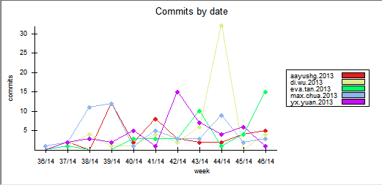
Subversion Log
CONSISTENT USE!
Notes:
Explain that wu di’s commits are high

Slide 24
Subversion Log
Notes:
Explain that wu di’s commits are high

Slide 25
Subversion Log
Reason(s) for slightly uneven Subversion log
Initially we didn’t keep track of commits and hence, committed randomly.
Wu Di’s commits were higher due to the role of being a project manager for 2 iterations.
Notes:
Planned vs Actual

Slide 26
Subversion Log
Audit | Iteration 1 | Iteration2 | Iteration 3 | Iteration 4 | Iteration5 | Iteration6 | Iteration7
Early | - | 1 | 1 | - | - | 1 | -
Match | - | 13 | 26 | 21 | 14 | 14 | 9
No Match | - | (+1) | 3(+2) | 1 | - | - | -
Total | - | 15 | 32 | 22 | 14 | 15 | 9
Notes:
Planned vs Actual

Slide 27
Subversion Log
In general, We have used Subversion Correctly!!!
Notes:
Planned vs Actual

Slide 28
Takeaways
“Equal work distribution is healthy for team dynamics”
“Using a schedule contributes to better time management”
“Voicing out disagreements and settling them in a diplomatic way is healthier.”
Notes:
Planned vs Actual

Slide 29
Team Conflicts?
Conflicts due to difference in opinions
→ Discuss reasons in detail and then vote to decide
Notes:
Planned vs Actual

Slide 30
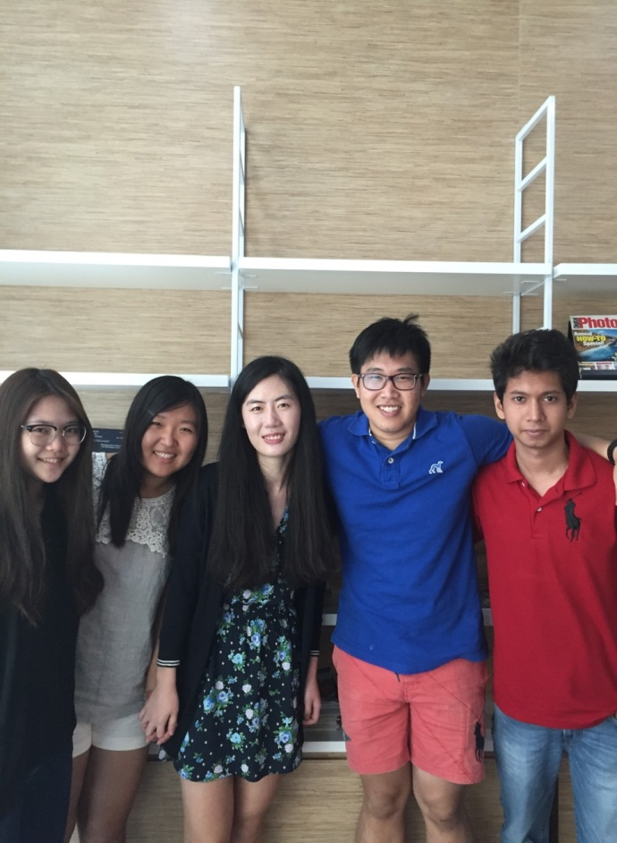
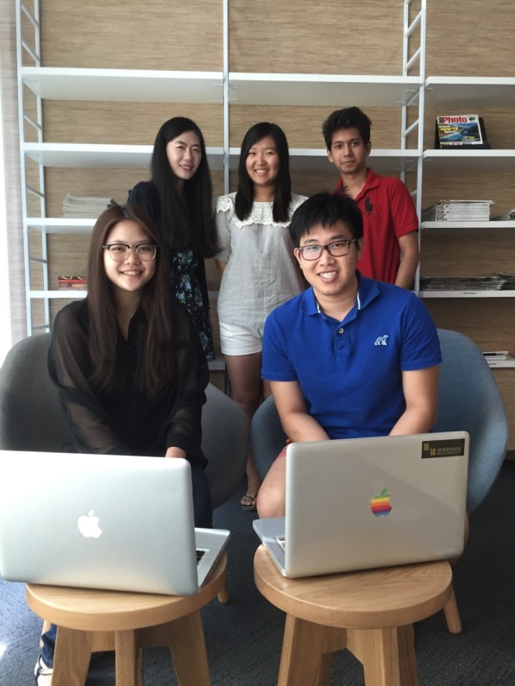
“None of us is as smart as all of us”
Notes:
Planned vs Actual

Slide 31


Aayush
Aayush is from New Delhi (India) but now lives in Singapore
He never ate a snail until the last day of SE Project Submission.
Notes:
Planned vs Actual

Slide 32
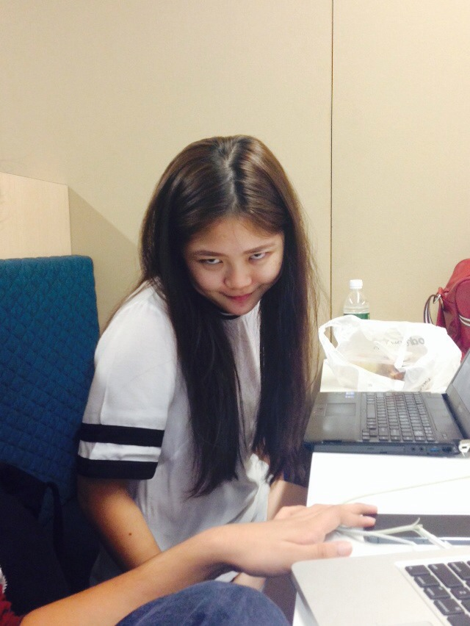
Eva
Eva dyed her hair for the first time due to stress from SE!
Notes:
Planned vs Actual

Slide 33
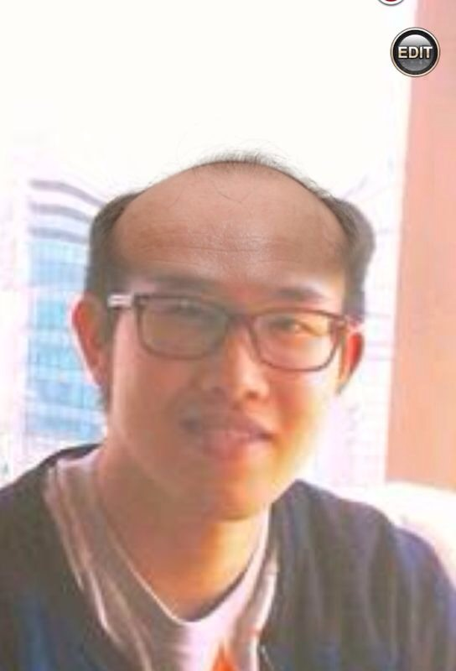
Max
Max loves to play Dota.
You will find him in the library EVERYDAY (and night)!
Notes:
Planned vs Actual

Slide 34
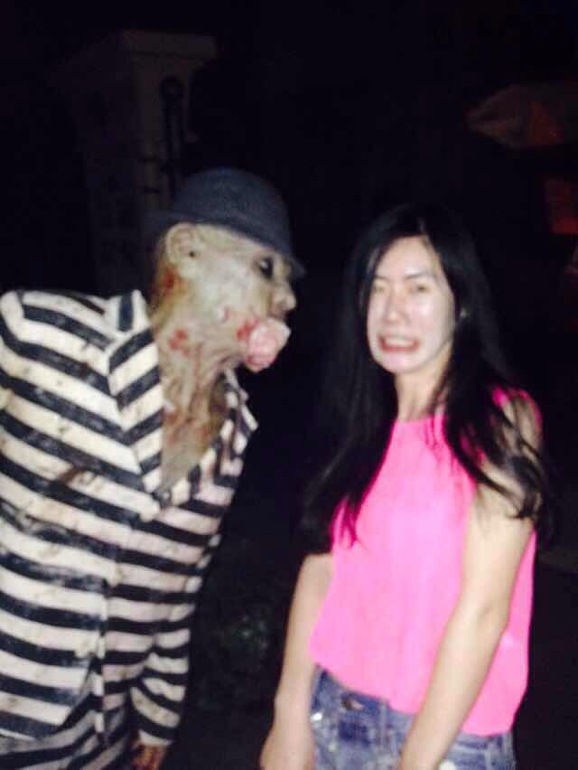
Wu Di
Wu Di loves to go shopping!
She is a Taekwondo Instructor and holds a black belt!!! (BEWARE)
The monster is scared of her
Notes:
Planned vs Actual

Slide 35

Yuxuan
Yuxuan(Goddess) is very good at coding and she loves Tea Party. ☺
She takes at least 6 modules every semester!!!!
Notes:
Planned vs Actual

Slide 36
Thank You!!!!
Notes:
Planned vs Actual

